Slide 1
Breakout Game Week 1
Team 3:
Murtaza Khambaty
Rohan Kasture
Vrishali Bhor
INDIANA UNIVERSITY BLOOMINGTON

Slide 2
Architecture Diagram
Breakout
action
Breakout (main)
entity
Ball
constants
Brick
Paddle
Clock
GraphicObject (Interface)
Constants (Interface)

Slide 3
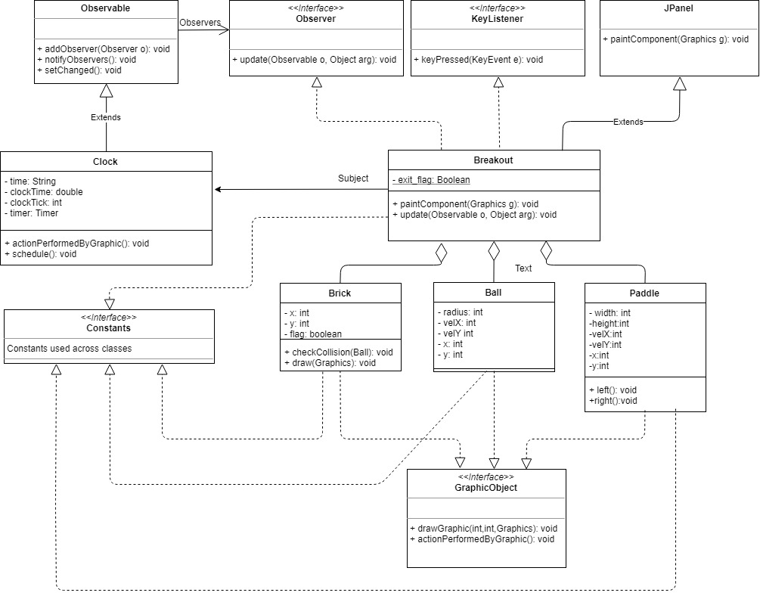
Class Diagram
SUBTITLE GOES HERE IF NECESSARY
Class Diagram

Slide 4
Teamwork
SUBTITLE GOES HERE IF NECESSARY
Designed the code structure
Segregated the work into 3 tasks.
Finally, merged all into one project
Breakout
Ball (Vrishali)
Brick (Rohan)
Paddle (Murtaza)

Slide 5
Demo
SECTION 4

Slide 6


